Slide 1






Titanic Survival Analysis Report
PRESENTED BY
Ali Mohamed Mostafa
IEEE SSCS

Slide 2



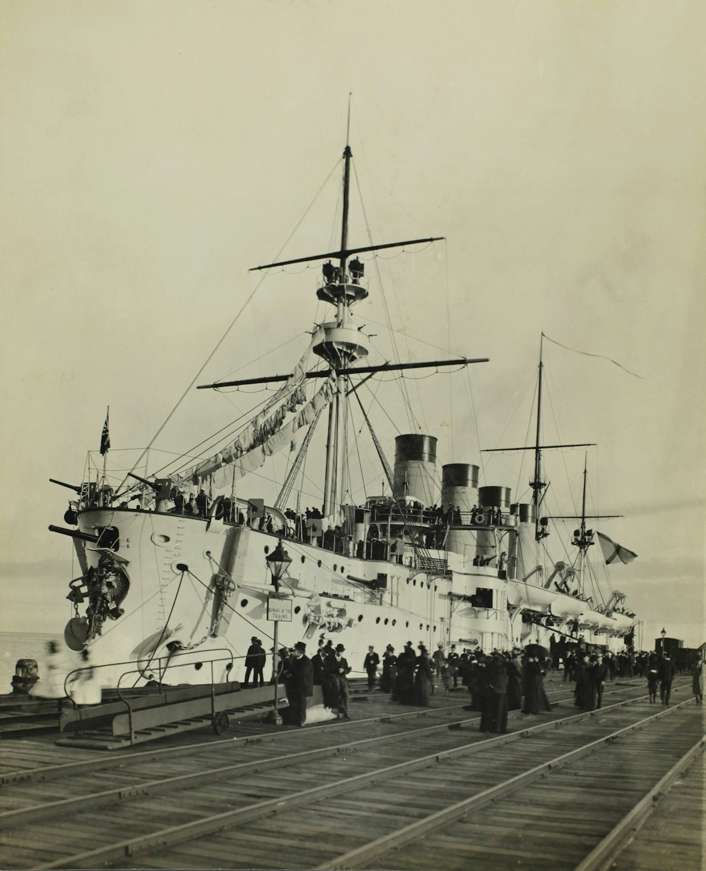


Titanic Survival Analysis Report
This presentation explores the Titanic dataset, revealing critical insights into passenger survival rates. By analyzing various factors such as gender, age, and class, we uncover trends that shaped survival outcomes. The findings highlight the significant impact of gender on survival, with females exhibiting higher survival rates across all classes. Join us as we delve into the data and uncover the stories behind the statistics, providing a comprehensive understanding of this historical maritime tragedy.

Slide 3




Introduction to Titanic Analysis
Exploratory Data Analysis
Objective of the Study
Dataset Overview
This report presents an exploratory data analysis of the Titanic dataset, aiming to uncover patterns and insights related to passenger survival.
The primary objective is to understand the factors influencing survival rates among passengers, providing a comprehensive overview of demographics and outcomes.
The Titanic dataset includes critical information such as passenger demographics, survival status, and missing values, essential for thorough analysis.

Slide 4


Titanic Dataset Overview
DATASET COMPOSITION
The Titanic dataset includes 887 passenger records, detailing attributes such as Age, Sex, Cabin, and Embarked, crucial for survival analysis.
MISSING VALUES
Key columns have missing data: Age (177), Cabin (687), and Embarked (2), which may impact analysis and require handling strategies.
SURVIVAL RATES INSIGHTS
Analysis shows that female passengers had significantly higher survival rates than males across all classes, highlighting demographic influences on survival.

Slide 5
Methodology Overview
Exploratory Data Analysis (EDA)
Python Libraries Used
The analysis utilized EDA techniques to uncover patterns and insights within the Titanic dataset, focusing on survival rates and demographic factors.
Key Python libraries such as Pandas for data manipulation, Matplotlib for plotting, and Seaborn for statistical visualizations were employed throughout the analysis.
Data Cleaning Steps
Visualizations Created
Data cleaning involved handling missing values, with 177 in Age, 687 in Cabin, and 2 in Embarked, ensuring a robust dataset for analysis.
Various visualizations were generated to illustrate findings, including survival rates by gender and class, enhancing understanding of the data.

Slide 6
Handling Missing Values
Missing Data Overview
Imputation Techniques
Impact on Analysis
The Titanic dataset has significant missing values: 177 in Age, 687 in Cabin, and 2 in Embarked, impacting analysis accuracy.
Various imputation techniques were applied, including mean substitution for Age and mode for Embarked, to enhance data completeness.
Addressing missing values improved the dataset's integrity, allowing for more reliable insights into survival factors among passengers.

Slide 7
Key Insights from Analysis
1
2
3
Higher Survival Rates for Females
Survival by Passenger Class
Impact of Age and Gender
Female passengers had significantly higher survival rates, with approximately 74% surviving compared to only 20% of male passengers across all classes.
Survival rates varied greatly by class: first-class passengers had a survival rate of 62%, while third-class passengers had only 25%.
Age and gender were critical factors; younger females had the highest survival rates, while older males faced the lowest chances of survival.

Slide 8


Survival Rates by Gender

Slide 9
Survival Rate by Embarkation Port

Slide 10
Survival Rate by Fare Group

Slide 11
Survival Rate by Fare Group
siblings && spouses
Parents && children

Slide 12
Conclusion of Findings
Valuable Insights
Impact of Gender
Need for Further Analysis
The Titanic dataset reveals critical insights into survival factors, highlighting the importance of gender and class in determining survival rates among passengers.
Analysis shows that female passengers had significantly higher survival rates, with approximately 74% surviving compared to only 20% of male passengers across all classes.
Further exploration of the dataset can uncover additional factors influencing survival, encouraging deeper investigation into historical maritime disasters and their implications.

Slide 13



Emotional Impact of Titanic
This visual captures the haunting image of the Titanic sinking, evoking the tragedy's emotional weight. It serves as a reminder of the lives lost and the lessons learned from this disaster.

Slide 14





Key Takeaways
The Titanic analysis highlights critical factors influencing survival, notably the significant advantage female passengers had over males. Additionally, addressing missing data is essential for accurate insights. Moving forward, further research could explore socio-economic impacts on survival rates, enhancing our understanding of historical events. This analysis not only informs historical perspectives but also emphasizes the importance of data integrity in research.

